Slide 1
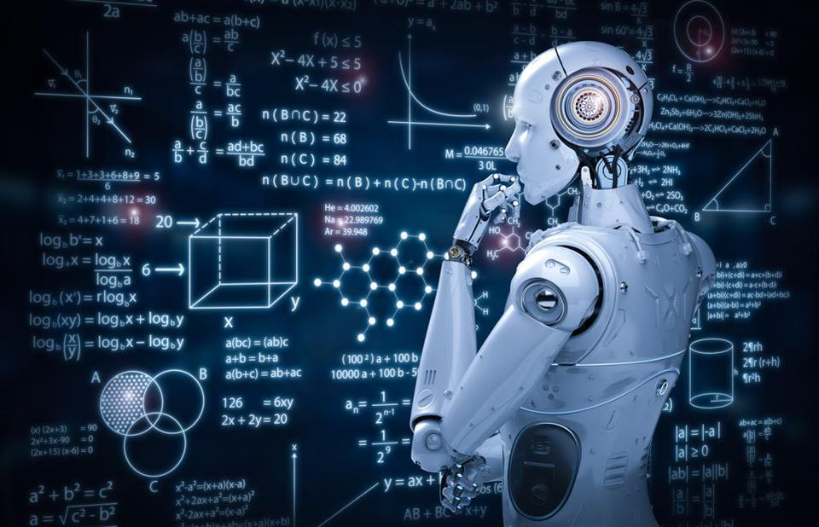
Machine Learning: Unveiling the Power of Data

Slide 2

What is Machine Learning
Machine Learning is a subset of Artificial Intelligence that enables computers to learn from data in order make decisions and Prediction..

Slide 3
Basic Components of Machine Learning
Data: Data is the foundation of machine learning. It consists of the input information that the model uses to learn and make predictions. Data can be structured (tabular data), unstructured (text, images), or semi-structured (JSON, XML). High-quality and relevant data are crucial for effective machine learning.
Features: Features are the specific attributes or characteristics of the data that the model uses to make predictions. Feature selection and engineering involve determining which features are most relevant to the problem and sometimes creating new features to enhance the model's performance.
Labels: These are the corresponding output values or categories that you want the model to learn to predict. Labels provide the desired target for the model's predictions.

Slide 4
Types of Machine Learning
Supervised Machine Learning
Unsupervised Machine Learning
Reinforcement Machine Learning

Slide 5
Supervised Machine learning
Supervised learning involves training a model on a labeled dataset, where the input data is paired with corresponding output labels.
Classification: Predicting discrete categories or classes. Example: Spam email detection.
Regression: Predicting continuous values. Example: Predicting housing prices based on features like area and location.

Slide 6
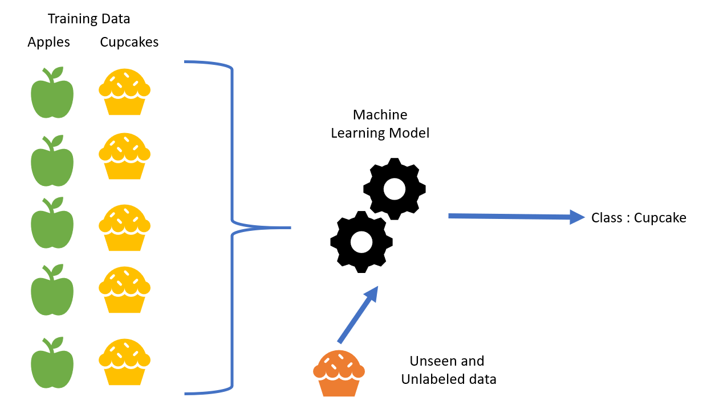
Supervised Machine learning

Slide 7
Supervised Machine learning
Linear Regression
Logistic Regression
Decision Trees
Random Forest
Support Vector Machines (SVM)
Naive Bayes
K-Nearest Neighbors (KNN)

Slide 8
Unsupervised Machine learning
Unsupervised learning involves training a model on an unlabeled dataset, where the goal is to uncover hidden patterns, structures, or relationships within the data. Since there are no predefined labels, the model identifies similarities or groupings based solely on the data's inherent characteristics
Clustering: Grouping similar data points together based on some similarity metric. Example: Customer segmentation for targeted marketing.

Slide 9
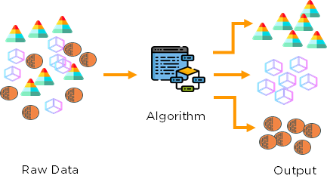
Unsupervised Machine learning

Slide 10
Unsupervised Machine learning
K-Means Clustering
Hierarchical Clustering
Principal Component Analysis

Slide 11
Machine Learning Process
Data Collection
Data Preprocessing
Model Selection
Model Training
Model Evaluation
Model Deployment

Slide 12
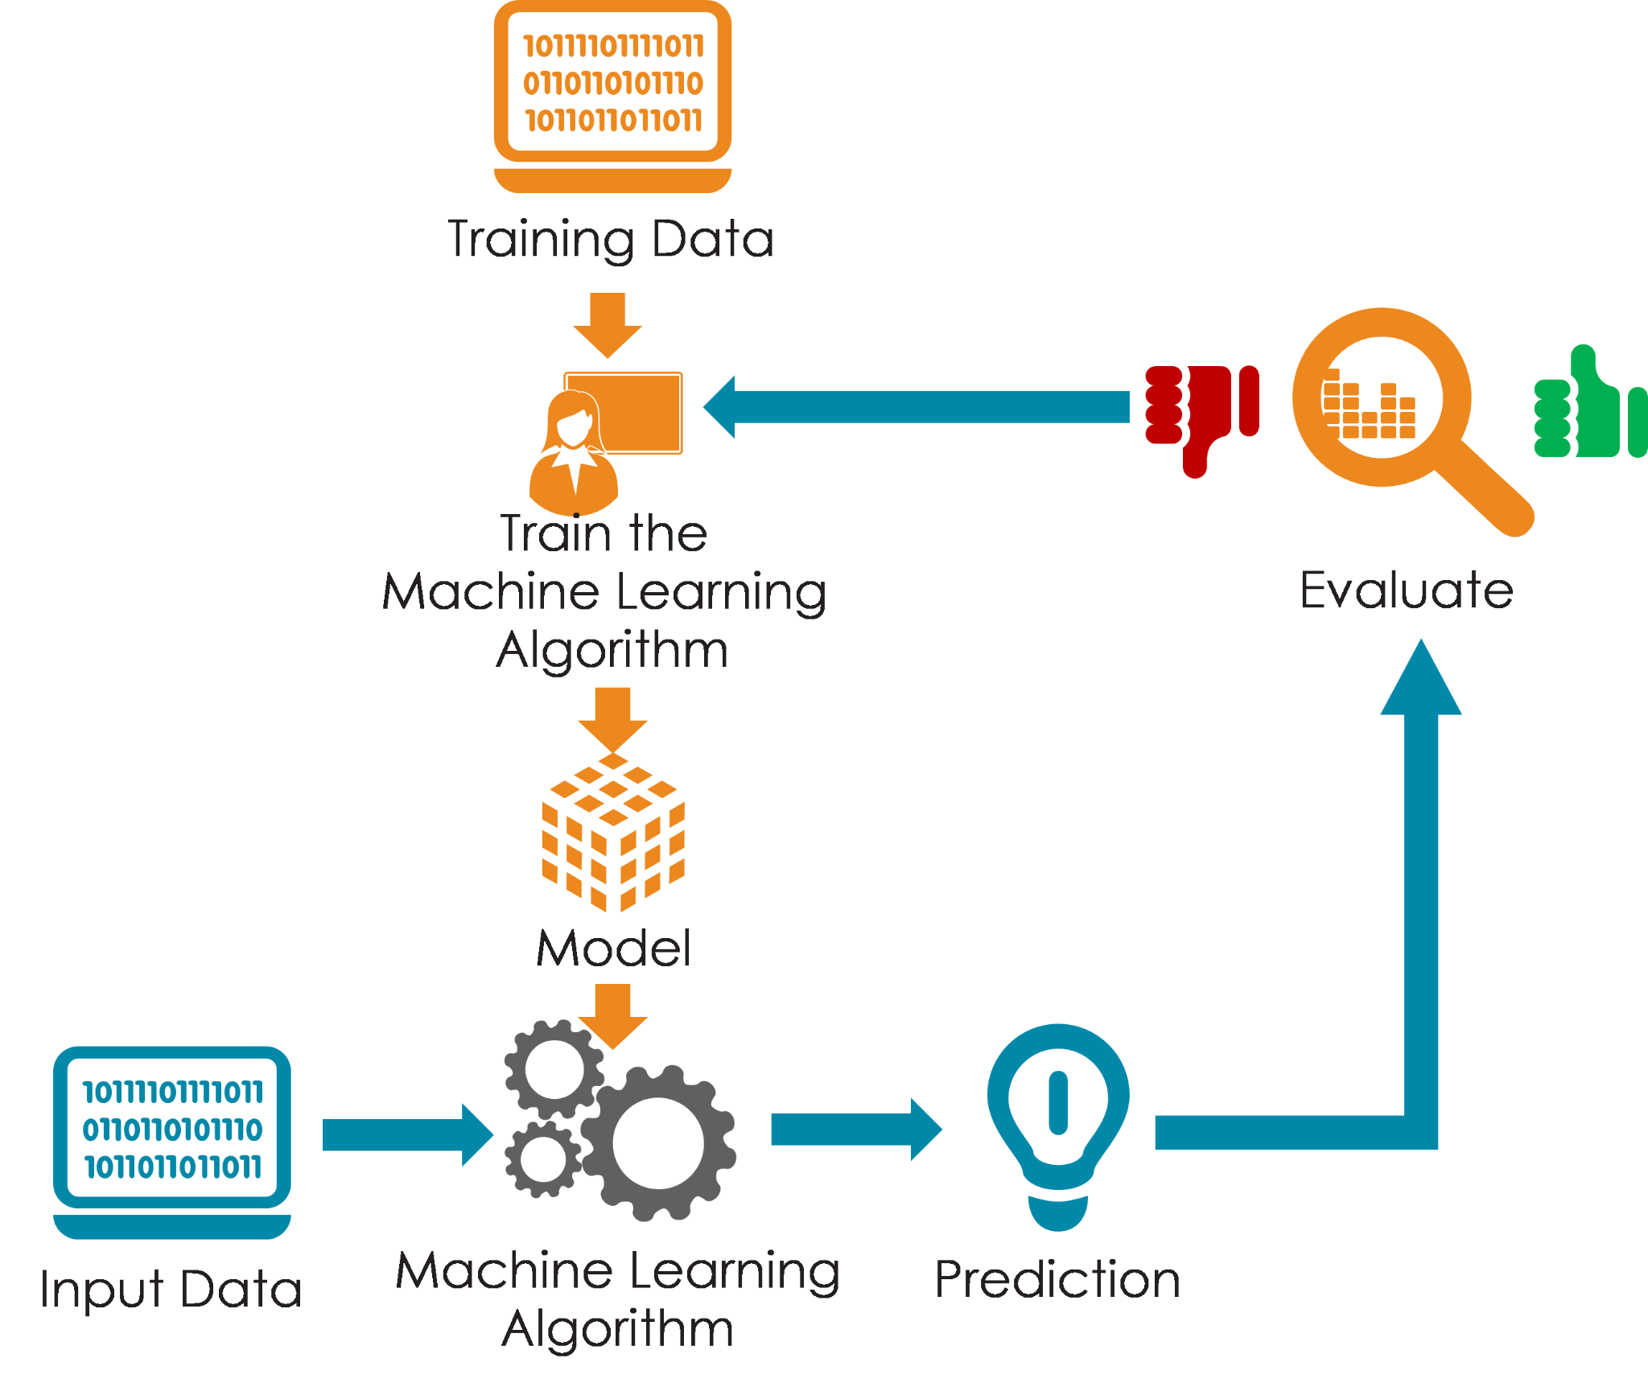
Machine Learning Process

